Slide 1
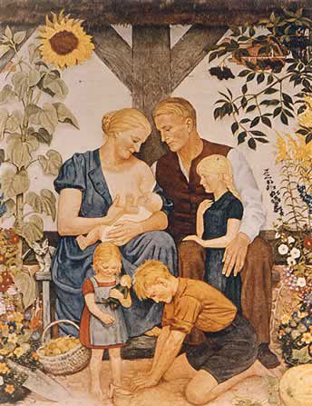
What does this photograph tell you about women in Nazi Germany?
Starter
Nazi propaganda poster from 1939

Slide 2
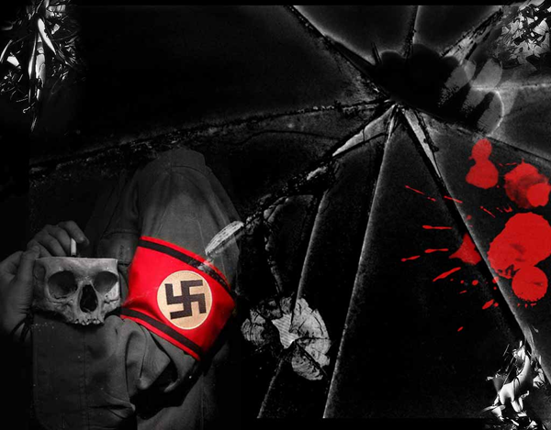
Nazi control of Women
How important were women to Nazi ideology?
Aim: To explain (B) or evaluate (A) the importance of women within Nazi society

Slide 3
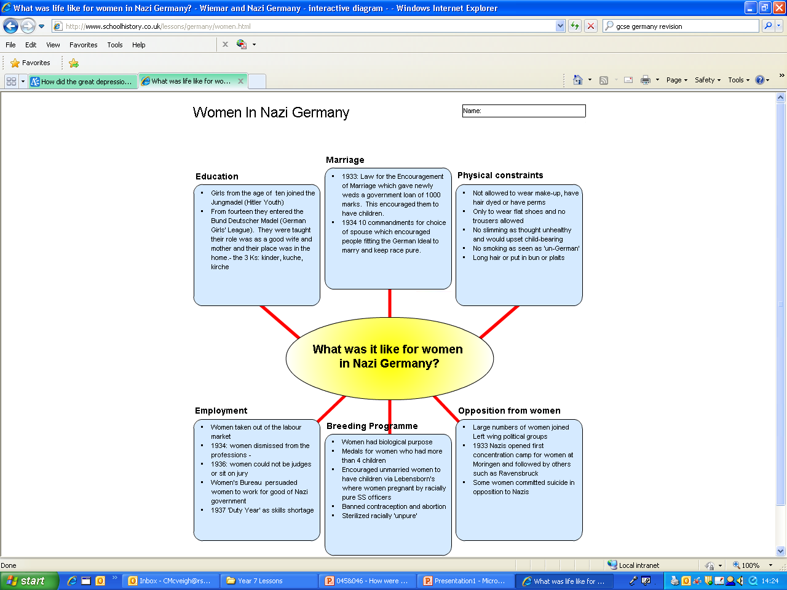

Slide 4
What was life like for women?
- Encouraged by loans, family allowances and child subsides to stay at home.
- Women were also given medals if they had a large family (Motherhood Cross System).
- Nazis banned birth control clinics, contraceptive and abortion.
- Word “family” was only given to households with 4 or more children.
Reactions
- Some always believed that their role was a domestic one and would have voted for Hitler in the first place.
- Others may have been converted to the Nazi idea and been proud of the new status of motherhood.
- Others were resentful because they had no choice in their new role.
- Some protested, and joined opposition groups because they believed:
Women would remain unfulfilled
Women were deprived of vital experience
Women had talents of particular types of employment.

Slide 5
Women were expected to raise large families
Nazis didn't want women to have too much freedom. They believed the role of women was to support their families at home. Women existed to provide children.
The League of German Maidens spread the Nazi idea that it was an honour to produce large families for Germany. Nazis gave awards to women for doing this.
At school, girls studied subjects like cookery. It was stressed that they should choose 'Aryan' husbands.
Women were banned from being lawyers in 1936 and the Nazis did their best to stop them following other professions. But the shortage of workers after 1937 meant more women had to go back to work.

Slide 6
Control of women
Ideal Nazi woman was traditional (no makeup, blonde, heavy hipped, athletic, flat shoes, did not work, did not smoke, cooked and brought up children, took no interest in politics).
Before 1933 women’s rights had made big steps in Germany. This was reversed by Nazi policy.
Massive propaganda campaign to promote motherhood.

Slide 7
Policies appeal?
1933 Law for the Encouragement of Marriage – loans given to couples provided the woman left her job. They got to keep a quarter of the money for each child they had.
On Hitler’s mother’s birthday, 12 August, medals were given to women with large families.
1938 changed the divorce law. A husband could divorce his wife if she could not have children.
Lebensborn was a programme where unmarried women could donate a baby to the Fuhrer by becoming pregnant by racially pure Aryan men.
The German’s Women’s Enterprise was set up who organised classes and talks on motherhood.

Slide 8
Kinder, Kuche, Kirche (3K’s)
Women were asked to stick to the 3 Ks – Kinder, kuche, Kirche (Children, cooking and Church).
Women were discouraged from higher education at school and at the League of German Maiden meetings.

Slide 9
Evaluation task
Which of the Nazi policies would have had the most influence on women?
Would Nazi policies have appealed to women? Explain your answers.

Slide 10
Examination technique
How important were marriage loans
How important were women to Nazi ideology?
How important was propaganda, amongst other factors, in ensuring women conformed to Nazi ideology

Slide 11
Source work
"In the Germanic nations there has never been anything else than equality of rights for women. Both sexes have their rights, their tasks, and these tasks were in the case of each equal in dignity and value, and therefore man and woman were on an equality."
Hitler in 1935
Explain the view point of the Nazis that is suggested in both sources.
Refer to both sources and your own knowledge in your answer (6)
"The mission of women is to be beautiful and to bring children into the world. This is not at all as.........unmodern as it sounds. The female bird pretties herself for her mate and hatches eggs for him. In exchange, the male takes care of gathering food, and stands guard and wards off the enemy."
Joseph Goebbels, written in 1929.

